Slide 1
CS118 – Programming Fundamentals
Lecture # 08
Monday, September 16, 2019
FALL 2019
FAST – NUCES, Faisalabad Campus
Course Instructor:
Ebad Majeed
Slides Credit:
Rizwan Ul Haq

Slide 2
string Type
Programmer-defined type supplied in ANSI/ISO Standard C++ library
Sequence of zero or more characters
Enclosed in double quotation marks
Null: a string with no characters
Each character has relative position in string
Position of first character is 0
Length of a string is number of characters in it
Example: length of "William Jacob" is 13

Slide 3
Using the string Data Type in a Program
To use the string type, you need to access its definition from the header file string
Include the following preprocessor directive:
#include <string>

Slide 4
Using string datatype
String Position of a Character in the String Length of String
----------------------------------------------------------------------------------
“Test String” Position of ‘T’ is 0 11
Position of ‘i’ is 8
Position of ’ ’ (the space) is 4
Position of ‘S’ is 5
Position of ‘g’ is 10
“String” Position of ‘S’ is 0 6
Position of ‘t’ is 1
Position of ‘r’ is 2
Position of ‘i’ is 3
Position of ‘n’ is 4
Position of ‘g’ is 5
When determining the length of a string, you must also count any spaces in the string. For example, the length of the following string is 22
“It is a beautiful day.”

Slide 5
Allocating Memory with Constants and Variables
Storing data in the computer’s memory is a two-step process:
Instruct the computer to allocate memory
Include statements in the program to put data into the allocated memory

Slide 6

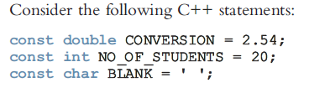
Contd..
Named constant: A memory location whose content is not allowed to change during program execution.
To allocate memory, we use C++’s declaration statements. The syntax to declare a named constant is:
Not Warn for mistyped value

Slide 7

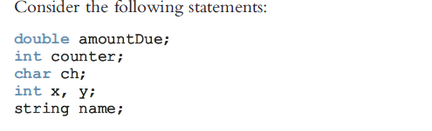
Variable
Variable: A memory location whose content may change during program execution. The syntax for declaring one variable or multiple variables is:
Simple data type
Const/Var can hold one value at a time

Slide 8
Assignment Statement
Should match datatype of variable
The assignment statement takes the form:
Expression is evaluated and its value is assigned to the variable on the left side
In C++, ‘=‘ is called the assignment operator
Value can be assigned by taking input from user

Slide 9
Assignment Statement (cont'd.)
Example 1:
int num1, num2;
double sales;
char ch;
float average;
string str;
num1 = 4;
num2 = 4 * 5 - 10 ;
sale = 0.03 * 50000;
ch = ‘A’;
str = “It is sunny day”;
================================================================
Example 2:
num1 = 18 ;
num1 = num1 + 27 ;
num2 = num1 ;
num3 = num2 / 5 ;
num3 = num3 / 4 ;

Slide 10
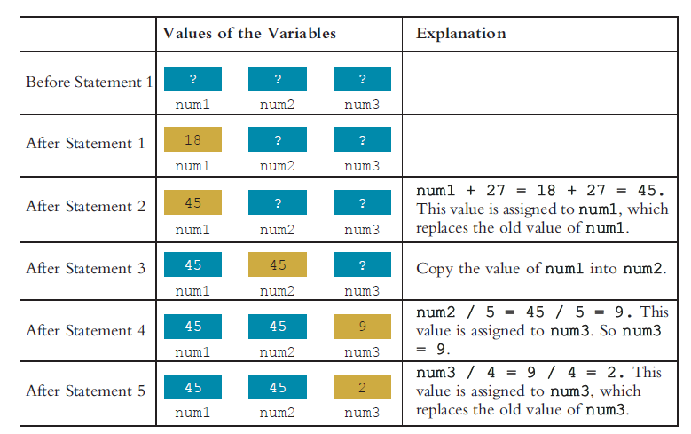
Variable and memory
num1 = 18 ;
num1 = num1 + 27 ;
num2 = num1 ;
num3 = num2 / 5 ;
num3 = num3 / 4 ;

Slide 11
Saving and Using the Value of an Expression
To save the value of an expression:
Declare a variable of the appropriate data type
Assign the value of the expression to the variable that was declared
Use the assignment statement
Wherever the value of the expression is needed, use the variable holding the value

Slide 12
Declaring & Initializing Variables
Variables can be initialized when declared:
int first=13, second=10;
char ch=' ';
double x=12.6;
All variables must be initialized before they are used
But not necessarily during declaration

Slide 13
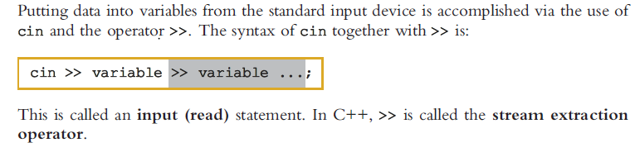
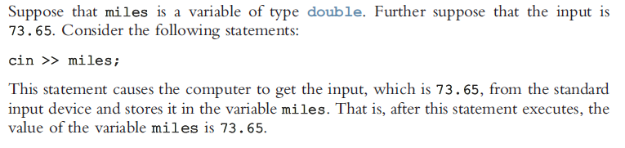
Input Statement

Slide 14
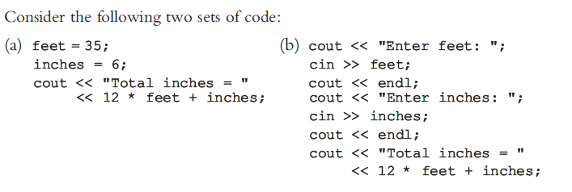
Two ways to initialize a variable

Slide 15
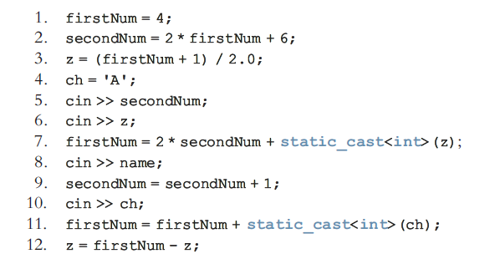
Example
int firstNum, secondNum;
char ch;
float z;
string name;
Notes:
cin >> secondNum ; //8
cin >> z ; // 16.3
cin >> name ; //Jenny
cin >> ch ; //D

Slide 16
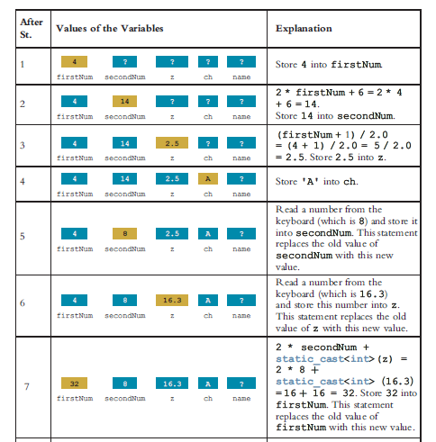

Slide 17
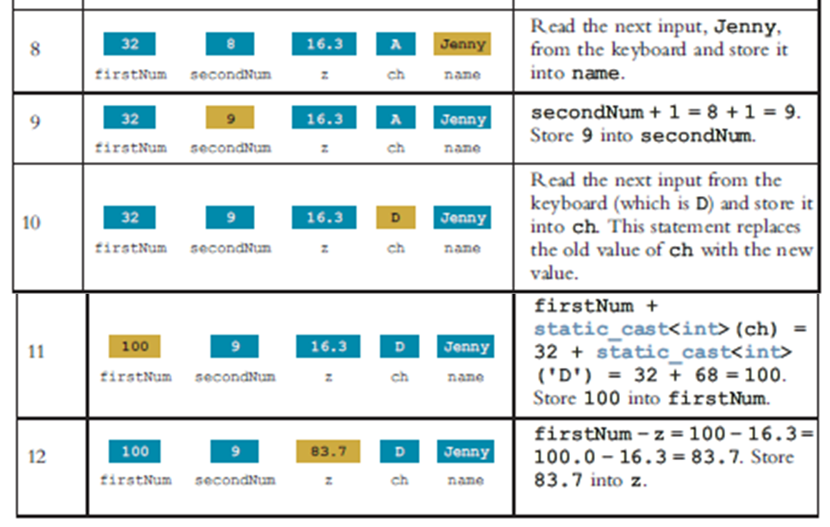
Cont.

Slide 18
Output
In C++, output on the standard output device is accomplished via the use of cout and the operator <<.
The general syntax of cout together with << is:
This is called an output statement. In C++, << is called the stream insertion operator. [This operator (<<) applied to an output stream is known as insertion operator. because inserts data into an output stream]
Generating output with cout follows two rules:
The expression is evaluated, and its value is printed at the current insertion point on the output device.
A manipulator is used to format the output. The simplest manipulator is endl

Slide 19
Practice of Cout<<
What is the output?
int a, b;
a = 65; //Line 1
b = 78; //Line 2
cout << 29 / 4 << endl; //Line 3
cout << 3.0 / 2 << endl; //Line 4
cout << "Hello there.\n"; //Line 5
cout << 7 << endl; //Line 6
cout << 3 + 5 << endl; //Line 7
cout << "3 + 5"; //Line 8
cout << endl; //Line 9
cout << a << endl; //Line 10
cout << “A" << endl; //Line 11
cout << (a + 5) * 6 << endl; //Line 12
cout << 2 * b << endl; //Line 13
Output of Statement at
7 //Line 3
1.5 //Line 4
Hello there. // Line 5
7 //Line 6
8 //Line 7
3 + 5 //Line 8
65 //Line 10
A //Line 11
420 //Line 12
156 // Line 13

Slide 20
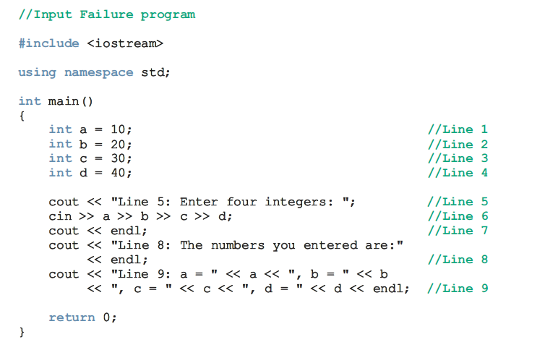

Slide 21
Output
Sample Run 1
Line 5: Enter four integers: 34 K 67 28
Line 8: The numbers you entered are:
Line 9: a = 34, b = 20, c = 30, d = 40
Sample Run 2
Line 5: Enter four integers: 43 225.56 39 61
Line 8: The numbers you entered are:
Line 9: a = 43, b = 225, c = 30, d = 40

Slide 22
Increment and Decrement Operators
Increment operator(++): increment variable by 1
Pre-increment: ++variable
Post-increment: variable++
int j = i++; // j will contain i, i will be incremented.
int j = ++i; // i will be incremented, and j will contain i+1.
Decrement operator (--): decrement variable by 1
Pre-decrement: --variable
Post-decrement: variable--
What is the difference between the following?
x = 9;
y = ++x;
x = 9;
y = x++;
Notes:
Write a program to find the difference between post & pre operators.
y = ++x; // y==6, x==6 y = x++; // y==5, x==6

Slide 23
More on Assignment Statements
C++ has special assignment statements called compound assignments
+=, -=, *=, /=, and %=
Example:
x = x * y ;
as
x *= y ;

Slide 24
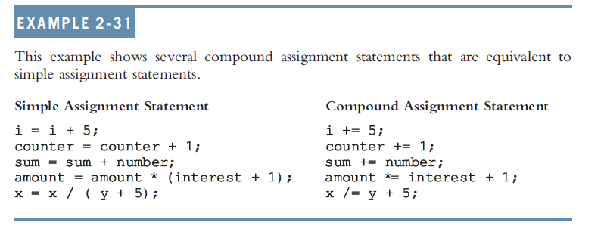
Example

Slide 25
Programming Example: Variables and Constants
Variables
int feet; //variable to hold given feet
int inches; //variable to hold given inches
int totalInches; //variable to hold total inches
double centimeters; //variable to hold length in
//centimeters
Named Constant
const double CENTIMETERS_PER_INCH = 2.54;
const int INCHES_PER_FOOT = 12;

Slide 26
Programming Example: Main Algorithm
Prompt user for input
Get data
Echo the input (output the input)
Find length in inches
Output length in inches
Convert length to centimeters
Output length in centimeters

Slide 27
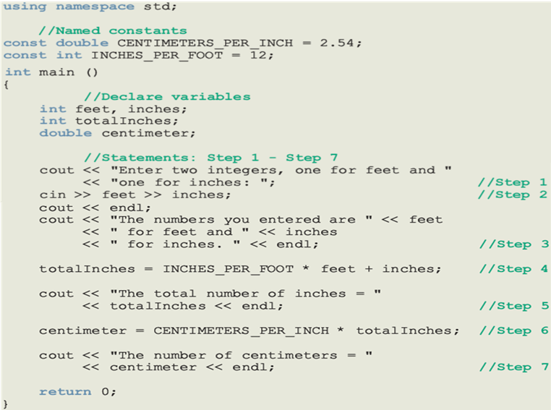
Writing a complete program

Slide 28
Programming Example: Sample Run
Enter two integers, one for feet, one for inches: 15 7
The numbers you entered are 15 for feet and 7 for inches.
The total number of inches = 187
The number of centimeters = 474.98

Slide 29
Questions

